Slide 1

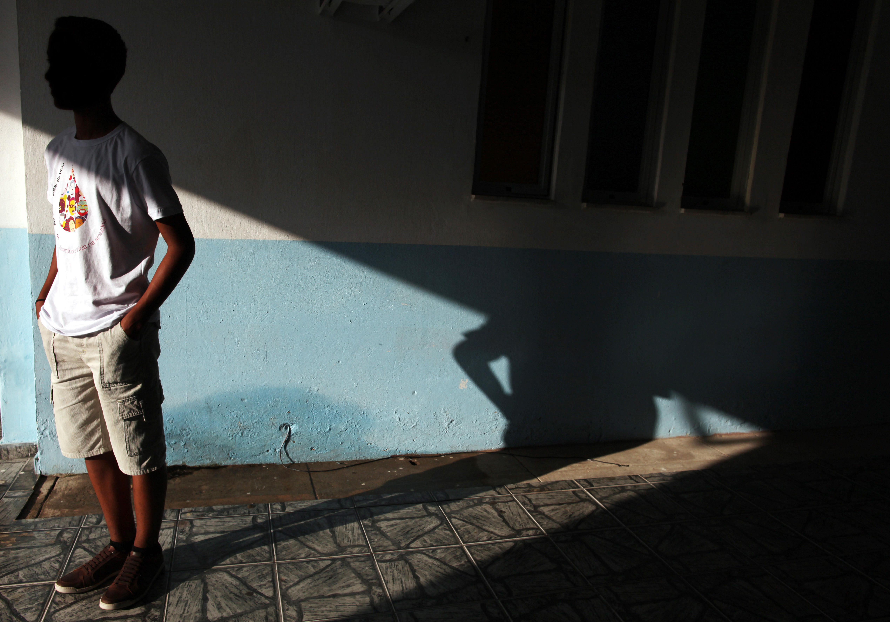
26 July 2018
Getting PrEP to young people
Alejandra Trossero
© UNICEF/Brazil/

Slide 2
Outline
Young people and HIV in Latin America and Caribbean
Steps towards availability
Challenges
Additional considerations for supplying PrEP
Adolescent «owned» demand

Slide 3
Young People and HIV in LAC
39,000 new infections in 2017 in people 15 − 24 years old – 7% less than in 2000
Source: UNICEF 2017
Notes:
The number of new infections per year in adolescents and young people has not changed much between 2010 and 2016, with a total of approximately 19,000 new infections in the age group of 15-19 years (with a reduction of 3% since 2010) and 20,000 new infections in the age group of 20-24 years (with a reduction of 4%)
In terms of distribution, gay man and men who sex with men and transgender people shared almost 50% of the burden of estimated new HIV infections.

Slide 4
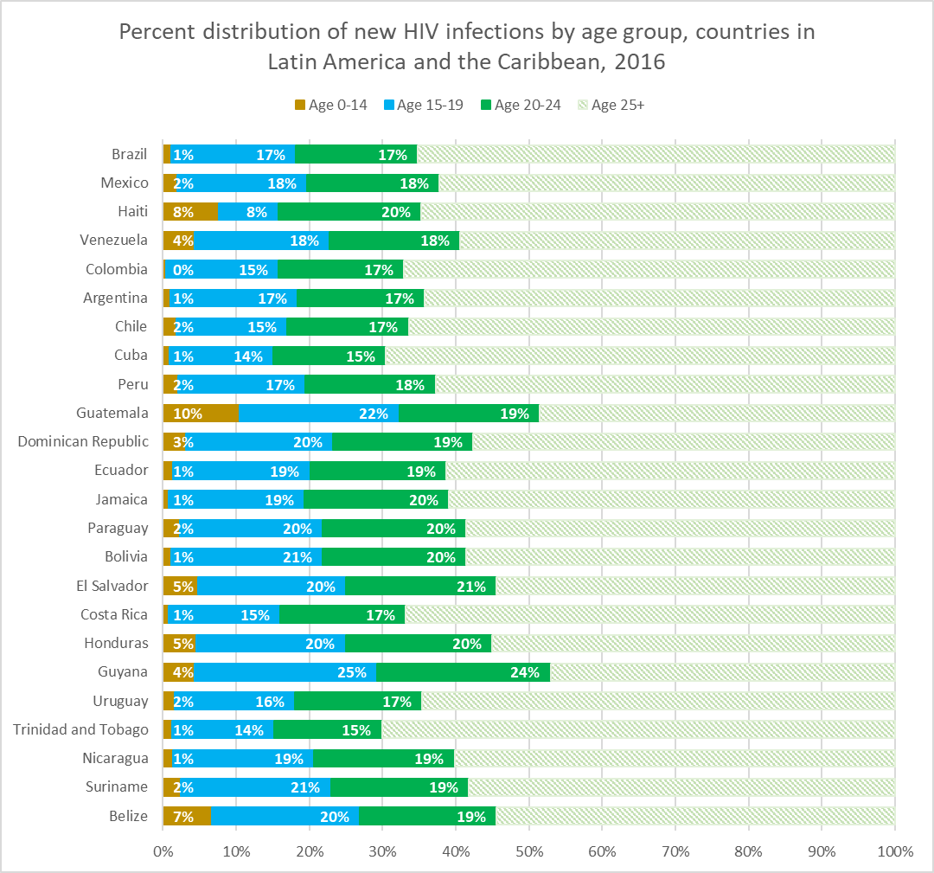
Notes:
Approximately one third of new infections take place among 15 – 24 years old, but in some countries this proportion is higher.

Slide 5
Source: UNAIDS/UNICEF/WHO Global AIDS Response Progress Reporting and UNICEF analysis of UNAIDS 2017 estimates
Notes:
In terms of sex distribution, we see an interesting pictures with more young men than women infected each year, with the exception of few countries in the Caribbean. 60% of new infections is taken place among young males.

Slide 6
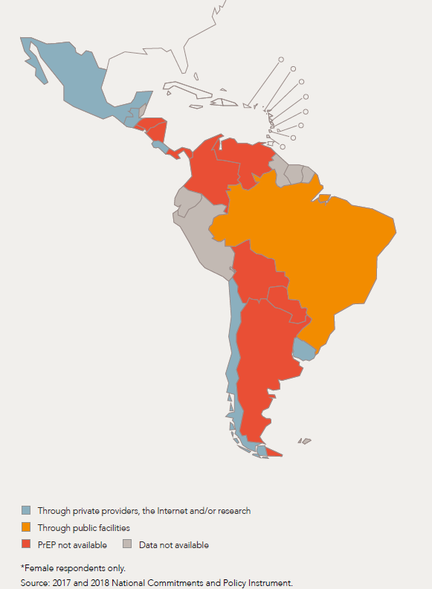
Steps towards availability
Available in Bahamas, Barbados y Brazil through the public sector for adult population and research underway for adolescent population in Brazil
Demonstration projects underway in 11 countries (7 LAC + 4 CAR: GTM, CUB, DOR, CHI, COL, MEX, PER, JAM, HAI, PRY)
It’s also available through private clinics and online in some countries.
Notes:
Looking now at PreP availability in the region, Brazil, Bahamas and Barbados have policies in place to provide PreP through the national health system for the adult population. A feasibility study for the adolescent population is underway in Brazil – as part of a UNITAID supported project.
Several demonstration studies are in development or started to be implemented through Global Fund grants.
PreP could also be accessible in private clinics and online.

Slide 7
A key challenge for access
Legal barriers prevent adolescents to access HIV related services.
Notes:
For most countries in LAC, access to sexual and reproductive health services continue to be challenging. Age of medical consent is usually around 18 years. While many countries reduce age of medical consent for adolescents to access HIV testing, medical treatment, including contraceptives for girls or any medical intervention can only be performed with the consent of parents. This is the case for accessing Truvada.
The possibility of a young gay man to disclose his sexual orientation to parents or tutors to access a pill that could protect them from HIV may not be a feasible reality for many young gay man in my region.

Slide 8

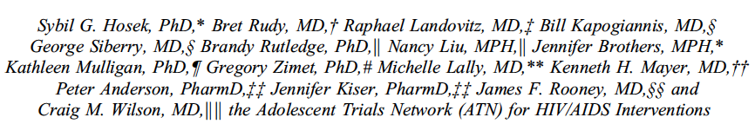
An open-label study that examined adherence to PrEP among a diverse sample of young MSM (18-22 years-old) in 12 US cities.
Acceptability of PrEP was high.
Most participants achieved protective drug levels during monthly visits. However, as visit frequency decreased, so did adherence.
CONCLUSION
Young MSM “may need PrEP access in youth-friendly settings
with tailored adherence support and potentially
augmented visit schedules.”
Notes:
Hosek, S. G., Rudy, B., Landovitz, R., Kapogiannis, B., Siberry, G., Rutledge, B., ... & Lally, M. (2017a). An HIV preexposure prophylaxis demonstration project and safety study for young MSM. Journal of acquired immune deficiency syndromes (1999), 74(1), 21-29.

Slide 9
Additional considerations for supplying PrEP
Young people’s lives are complicated – STI risks vary, adherence to daily treatment can be challenging.
Risk perceptions about HIV (and many other issues) tend to be low among young people.
Sexual relationships are new - anticipating and negotiating risks can be hard to do
Health services are not always seen as relevant for them - young people do not go to health facilities!
Notes:
FDA has approved PrEP for adolescents this year. WHO has launched last week an implementation module.
PrEP is more than a pill, it implies continue interaction with health care providers, at a time when the perception of risk varies. Studies with adolescents showed that risk perception tend to be low among adolescents and those at higher risk do not always decide to take PrEP.
Adolescents who seek PrEP, many not want to be perceived as engaging in “unsafe” practices and could feel more stigmatized or being perceived at taken risks..
Adherence could also be an issue – where to hide the bottle, what if parents or friends see them taking pills. Issues of privacy and confidentiality could affect access and adherence.
There is also the paradox of who should deliver PrEP to adolescents. HIV specialists who are knowledgeable about PrEP do not often see HIV-negative patients and primary care physician who see HIV-negative patients are not trained to provide PrEP.

Slide 10
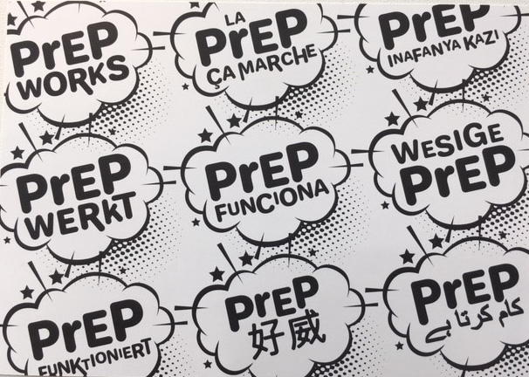
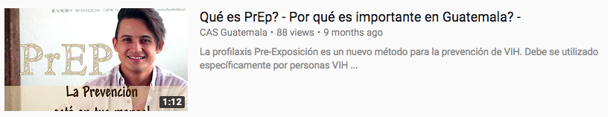
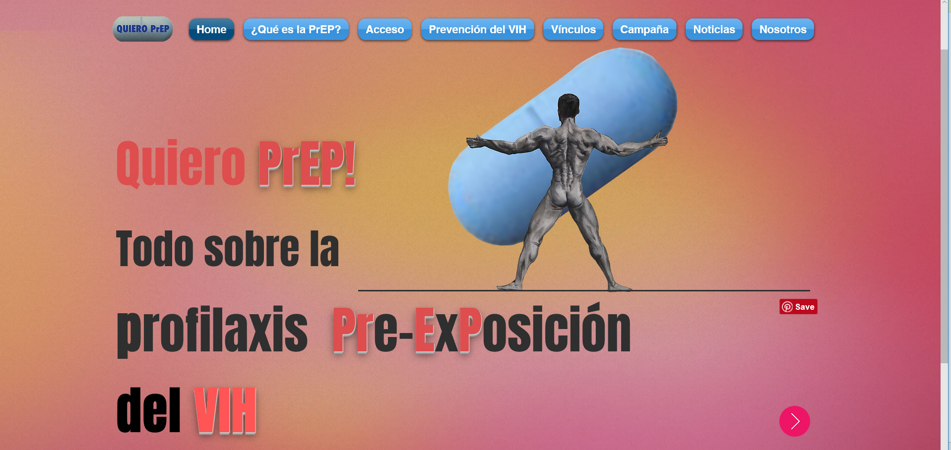
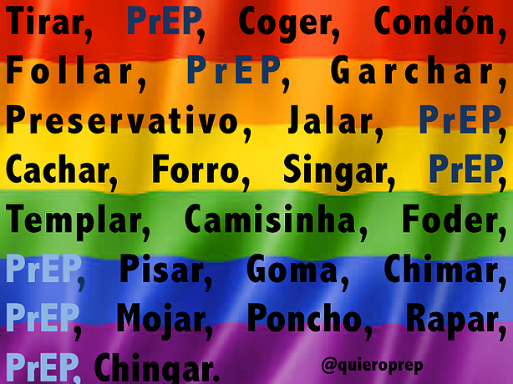
Adolescent «owned» demand
Notes:
How to generate demand then? The three images in the screen are some of the info that could be find online – the quiero PrEP campaign make it very explicit that the information if for people older than 18 years old.
I would like to invite you think about the time when you were an older adolescent, perhaps you share the same feeling than I do. We had the impression that we were inventing sex. Adolescence is a time of creation and exploration – we did not want adults to tell us what to door how to do it. Why young people should accept it now.
PreP is a choice for this new generation, but they need to own it and drive the demand. It is not about us, telling them what and how to do. it’s about young people finding their way to talk about PreP, to make it more appealing, more sexy. They need to own it and theme it in a way that it talks to this youth generation. We need to step back and facilitate this process.
Any demand creation approach should go beyond protection messages, to explore desire, pleasure, social connections, well-being.
It should be their invention….not ours!!!

Slide 11
Acknowledgements
I would like to thank the following people:
Julien Brisson – University of Montreal (Canada)
Juan Pablo Gutierrez – Instituto Nacional de Salud Publica (Mexico)
Aleya Khalifa - UNICEF
Javier Hurcade Beloq – Independent consultant (Argentina)
Sam Avrett – Fremont Center (USA)
Giovanni Ravasi – PAHO

Slide 12



Thank You

